Slide 1
Introduction to Database Modelling
Lecture - 04

Slide 2
Introduction to Database
To better understand what drives the design of databases, first need to understand the difference between data and information.
What is Data?
What is Information?
What is Database (DB)?
What is Database Management System (DBMS)?

Slide 3
File based Approach
This is one of the obsolete approach which used to data management. Such a system would typically consist of a set of application programs (separate computer files) that perform various tasks. Each program would define and manage its own data.
Basic File Terminologies
Data
Field
Record
File
Cont.

Slide 4
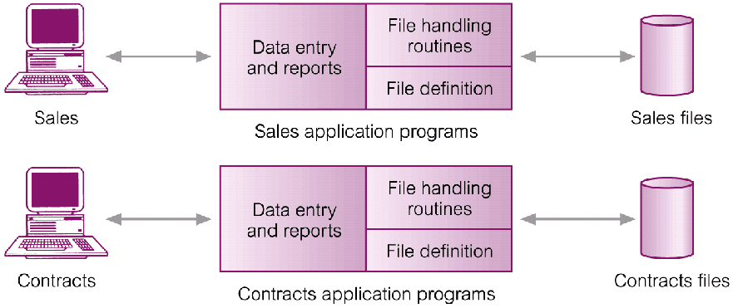
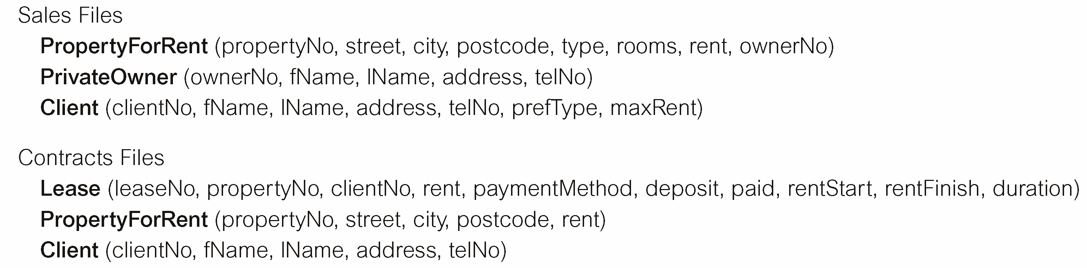
File based Approach
Cont.

Slide 5
File based Approach
Cont.
Billing
Program
Purchasing
Program
Customer
file
Accounts
receivable
file
Buyer
file
Inventory
file
Vendor
file
Sales Order Processing
Program
Accounts Payable
Program
Payroll
Program
Vendor
file
Invoice
file
Customer
file
Inventory
file
Employee
file

Slide 6
Database Approach
Cont.
Limitations of Conventional File-based Approach:
Uncontrolled redundancy ( data redundancy)
Data inconsistence
Inflexibility
Limited data sharing
Poor enforcement of standards
Extensive program maintenance
Directed Reading Section 1.1 and 1.2 in Elmasri and Navathe.

Slide 7
Database Approach
Arose because:
Definition of data was embedded in application programs, rather than being stored separately and independently
No control over access and manipulation of data beyond that imposed by application programs
Result:
The Database and Database Management System (DBMS).
Cont.

Slide 8
Database Approach
Order Dept.
Accounting
Dept.
Payroll
Dept.
Program
A
Program
B
Program
C
Ordering
filing
System
Invoicing
System
Payroll
System
Back
Orders
file
Inventory
Master
file
Customer
Master
file
Inventory
Pricing
file
Employee
Master
file

Slide 9
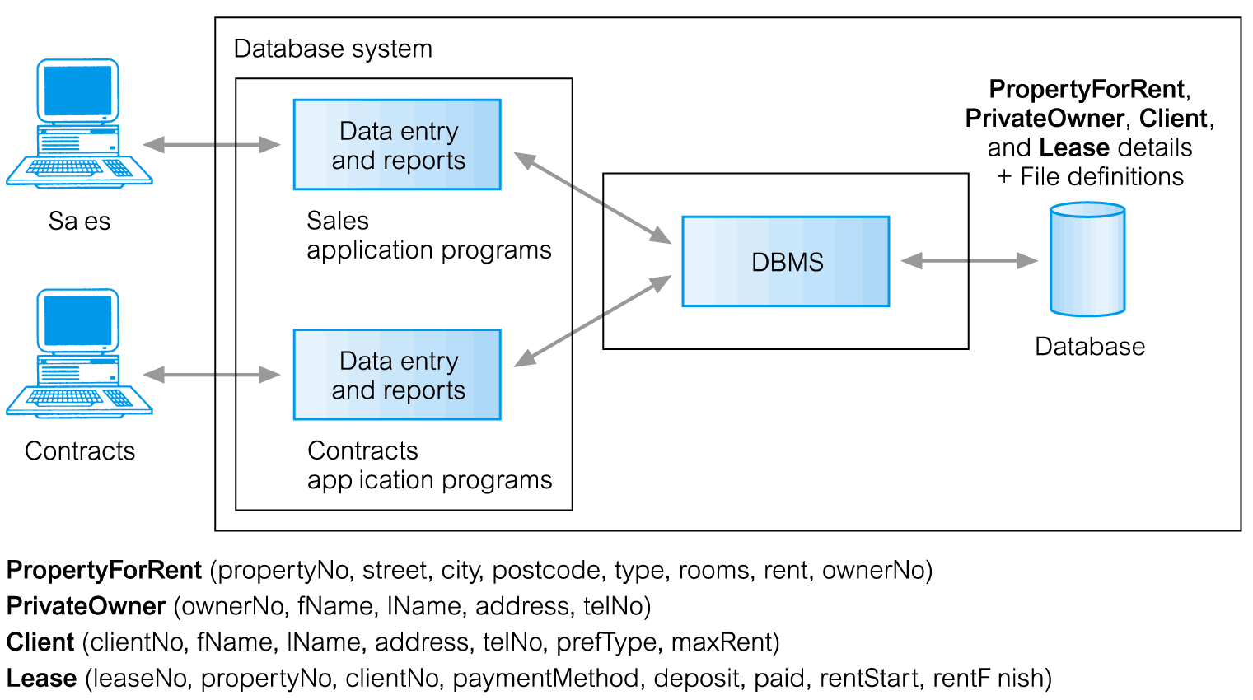
Database Approach
Cont.

Slide 10
History in a Nutshell
Cont.
First DBMS: Bachman at General Electric, early 60’s (Network Data Model). Standardized by CODASYL.
Late 60’s : IBM’s IMS (Inf. Mgmt.Sys.) (Hierarchical Data Model).
1970: Edgar Codd (at IBM) proposed the Relational Data Model. Strong theoretical basis.
1980’s -90’s: Relational model consolidated. Research on query languages and data models => logic-based languages, OO DBMSs => Object-relational data model (extend DBMSs with new data types)

Slide 11
Database system Environment
Cont.
Database system environment normally can be considered to have five major parts.
Hardware
Software - Operating System Software, DBMS Software Application Program and Utilities
People - System Administrators, DB Administrators, DB Designers, System Analyst and Programmers, End Users
Procedures
Data
Directed Reading Section 1.4, 1.5 and 1.6 in Elmasri and Navathe.

Slide 12
Database Management System
Cont.
“Database is a logically coherent collection of data with some inherent meaning.”
DBMS is a collection of programs that enables users to create and maintain a database
“DBMS is a general purpose software system that facilitates the processes of defining, constructing, manipulating, and sharing databases among various users and applications”

Slide 13
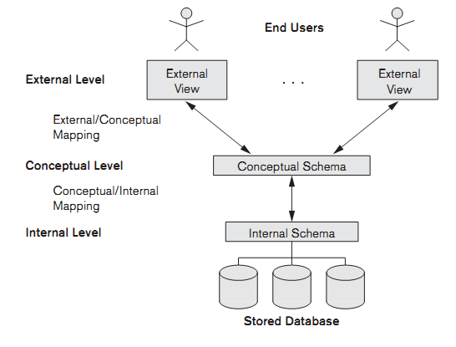
Cont.
Three-Tier Architecture of a DBMS

Slide 14
Cont.
Three-Tier Architecture of a DBMS
The main objective of the three-schema architecture is to separate a user’s views of the database from the way that the data is physically represented.
All users should be able to access same data
A user’s view is immune to changes made in other views
Users should not need to know physical database storage details
DBA should be able to change database storage structures without affecting the users’ views
Internal structure of database should be unaffected by changes to physical aspects of storage
DBA should be able to change conceptual structure of database without affecting all users

Slide 15
Three-Tier Architecture of a DBMS
Defines DBMS schemas at three levels:
Internal schema at the internal level to describe physical storage structures and access paths. Typically uses a physical data model.
Conceptual schema at the conceptual level to describe the structure and constraints for the whole database for a community of users. Uses a conceptual or an implementation data model.
External schemas at the external level to describe the various user views. Usually uses the same data model as the conceptual level.

Slide 16
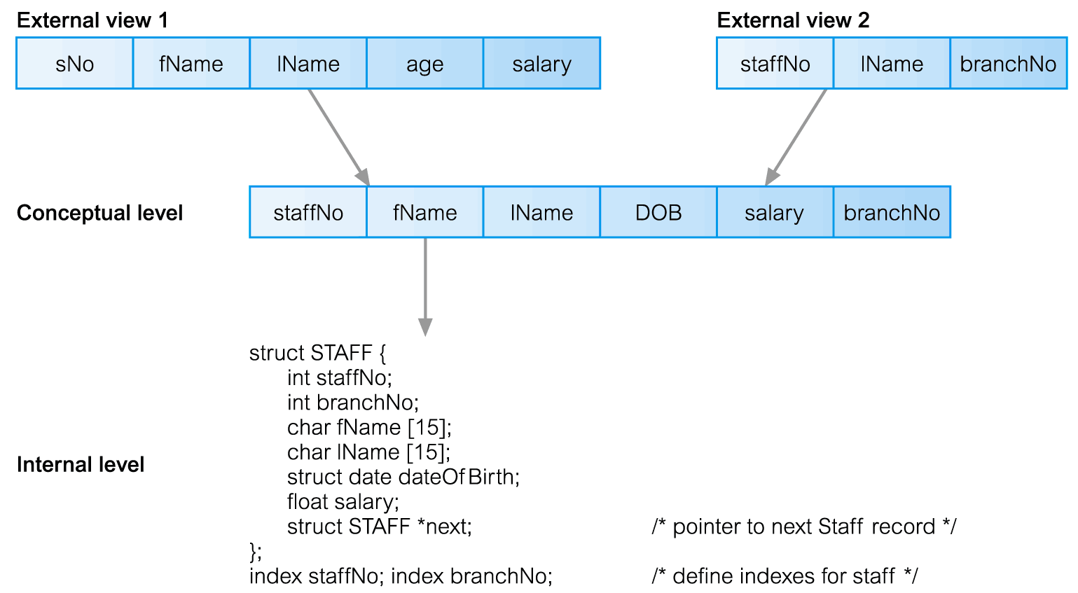
Cont.
Three-Tier Architecture of a DBMS

Slide 17
Cont.
Data Independence
Data Independence is the capacity to change the schema at one level of a database system without having to change the schema at the next higher level
Logical Data Independence: Change conceptual schema without having to change external schemas and their application programs.
Physical Data Independence: Change internal schema without having to change conceptual schema.

Slide 18
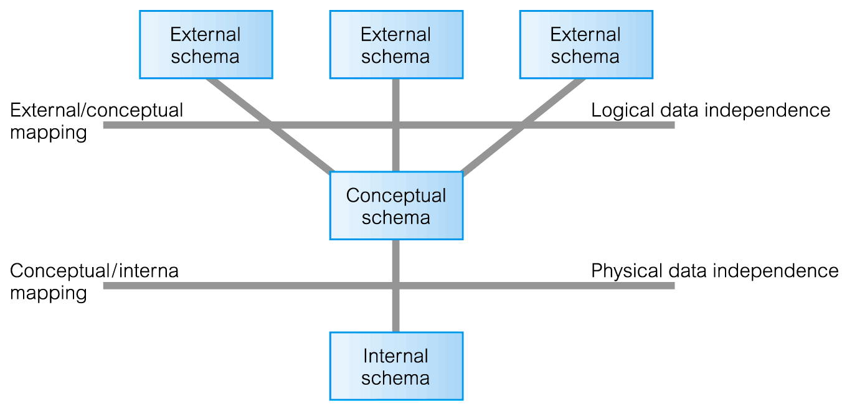
Data Independence

Slide 19
Database Design
Why is Database Design important?
Without careful planning you may create a database that…
contains unnecessary data which occupies the storage space
omits data required to create critical reports
takes a considerable time to respond to user questions
produces results that are incorrect or inconsistent
is unable to accommodate changes in the user's requirements
A poorly designed database will require more time in the long-term…!

Slide 20
Database Design process
1.Requirements Analysis
What does the user want?
2.Conceptual Database Design
Model Data requirements using a Conceptual Data Model --> ER model
3.Logical Database Design
Model Data requirements using a Logical Data Model → Relational Data Model
4.Schema Refinement
Fine tune the result
5.Physical Database Design
Implementation of the design using a Database Management System
6.Security Design
Implement Controls to ensure security and integrity

Slide 21
Data Modeling
What is a Data Model?
A data model focuses on what data should be stored in the DB and how it should be organized
Without representing the data as a database would see it, a data model represents the data as the user sees it in the ‘real world’
A data model can be considered similar to an architect's building plan
The goal of the data model is to make sure that all data objects required by the database are completely and accurately represented

Slide 22
Types and Examples of Data Models
1) High Level Conceptual Data Models
Provide concepts for presenting data in ways that are close to the way people perceive data.
Ex: Entity Relationship Model/Diagram

Slide 23
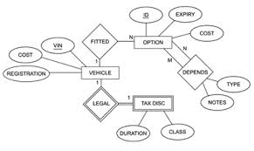
Entity Relationship (ER) Model
Represents data as ‘real world’ Objects (Entities)

Slide 24
Types and Examples of Data Models …
2) Record-based Logical Data Models
Provide concepts users can understand but are not too far from the way data is stored in the computer
Ex: Hierarchical Model,
Network Model,
Relational Model,
Object Oriented Model, etc…

Slide 25
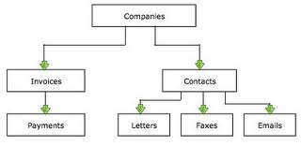
Hierarchical Model
Represents data as a hierarchical tree structure. Each branch of the hierarchy represents a number of related records.

Slide 26
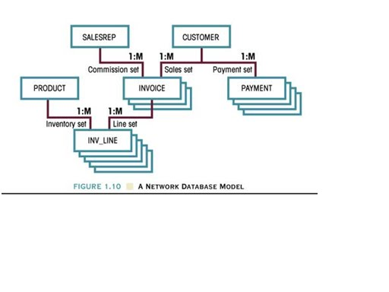
Network Model
Represents data as record types

Slide 27
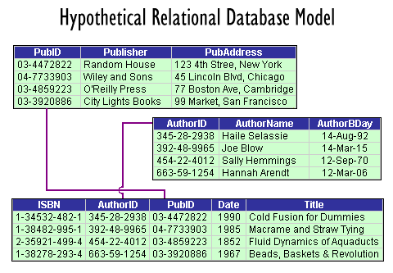
Relational Model
Represents data as relations/tables

Slide 28
Properties of a good Data Model
Completely and accurately represents the data requirements of the end users/application
Uses simple notations and natural language so it can be easily understood by the end user
Detailed enough to be used by a database designer to build the database.
Eliminates redundant data
Independent of any hardware and software constraints
Adapts to changing requirements with minimum of effort

Slide 29
Database Design process (Revisited)
1.Requirements Analysis
What does the user want?
2.Conceptual Database Design *
Model Data requirements using a Conceptual Data Model --> ER model
3.Logical Database Design *
Model Data requirements using a Logical Data Model → Relational Data Model
4.Schema Refinement *
Fine tune the result
5.Physical Database Design
Implementation of the design using a Database Management System
6.Security Design
Implement Controls to ensure security and integrity
* Will be discussed in this module

Slide 30
Step 1: Requirements Analysis
The goals of the requirements analysis are:
to determine the data requirements of the database in terms of objects
to identify and describe the information about these objects
to identify the relationships among these objects
to identify different transactions that will be performed on the database
to identify performance, integrity, security or administrative constraints to be imposed on the database
to identify design and implementation constraints if any (ex: specific technologies, hardware and software, programming languages, policies, standards, etc…)

Slide 31
Step 1: Requirements Analysis…
Information needed for the requirements analysis can be gathered in several ways:
Review of existing documents –
Can become familiar with the organization/ activity you need to model by reviewing the existing documentation. Ex: existing forms and reports, written guidelines, job descriptions, personal narratives, etc…
Interviews with end users –
Can organize individual/group meetings with the end users. Can use a blackboard, flip chart, or overhead transparencies to record information gathered from the interviews.
Review of existing automated systems –
Can review the system design specifications and documentation, if the organization already has an automated system

Slide 32
Step 2: Conceptual Database Design
The information gathered in the requirements analysis phase is used to create a:
high-level description of the data in a conceptual data model or Semantic Data Model.
Eg. ER Model

Slide 33
Step 3: Logical Database Design
In this step, we determine the DBMS to implement the database & also the data model.
We utilize the conceptual schema created in the previous step and convert it into a schema of a particular data model* (e.g. Relational Data Model )
*we will cover this in the next two lectures.

Slide 34
Step 4: Schema Refinement
The schema created by the logical database design phase is further refined for potential problems such as redundancies.

Slide 35
Step 5: Physical Database Design
In this step, performance criteria are taken into consideration and further enhancements to the schema & creation of indexes are considered.

Slide 36
Step 6: Security Design
Different user groups and their roles are identified.
Appropriate levels of access are then provided to the data ensuring that users have access to only the necessary data.
Eg. Bank
Customer – read access
Teller – read/update (limited)
Manager – read/update

Slide 37
End of Lecture - 04
Questions ?

